Slide 1

GME
PG Payment Service Provider Business Plan
By Yoel Thapa
2021.07.20

Slide 2
Table of contents
Objective
2. Industry
a) B2B Cross Border Market Size for GME
b) Online Shopping Payments in Korea
b-1) Top Online Shopping Marketplaces in Korea
c) Cross Border Transaction Size
d) Inbound E-commerce Transaction Volume 2020
e) Tuition Payments
f) Tuition Payments Market Size
3. GME's Position :
3.1 GME’s Position in Flow
3.2 Local Competitors and Services
3.3 Volume, Revenue and GME's Share
3.4 Product & Services
3.5 GME SWOT Analysis
3.6 Methods to Achieve the Target
Work Process
RoadMap and Actions
6. Conclusion

Slide 3
Objective
To Identify GME’s Position in the Korean B2B Market and
set the goal for 2022 & 2023

Slide 4
2. Industry : a) B2B Cross Border Market Size for GME
* 1 USD= 1140원 기준
Source: 통계청
Notes:
5조 9천 995억 for selling in 2019.

Slide 5
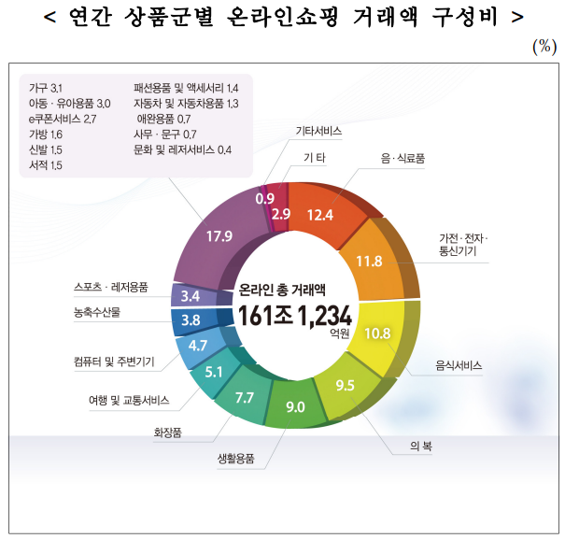
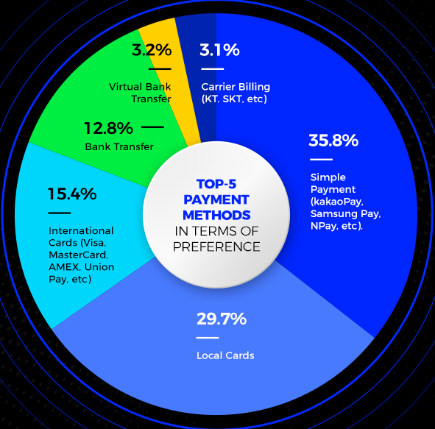
2. Industry : b) Online Shopping Payments in Korea
Market size for Online Shopping 2020 was approximately $141.3 Billion including Cross Border Payments.
Product Wise Ratio for Total of 141 Billion USD
Payment Method wise for Total 141 Billion USD
Source: Rapyd
Source: 통계청

Slide 6
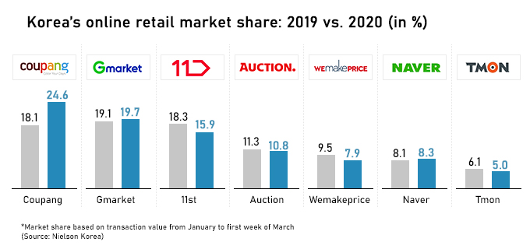
2. Industry : b-1) Top Online Shopping Marketplaces in Korea
Other popular Marketplaces for Koreans : https://www.seven-hub.com/homepage/integration

Slide 7
2. Industry : c) Cross Border Transaction Size
Cross Border Transaction Volume : Online Selling and Buying Transaction Volume
Title | Year 2019 | Year 2020 | Growth | 2021(Projected)
Total | 8.89 | 9.32 | 4.84% | 10 Billion USD
Selling Korean Goods (Inbound) | 5.26 Billion USD | 5.22 Billion USD | -0.63% | 5.19 Billion USD
Buying Foreign Goods (Outbound) | 3.13 Billion USD | 4.10 Billion USD | 13% | 4.74 Billion USD
* 1 USD= 1140원 기준
Source: 통계청
Notes:
5조 9천 995억 for selling in 2019.

Slide 8
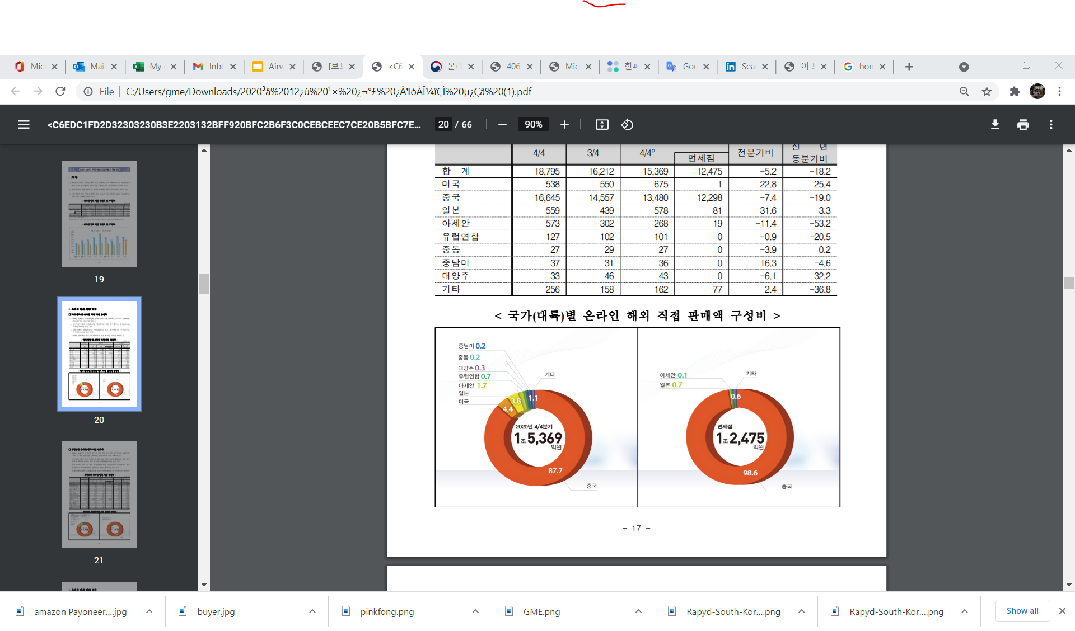
2. Industry : d) Inbound Online E-commerce Transaction Volume for 2020, 4th Quarter
Source: 통계청
Notes:
5조 9천 995억 for selling in 2019.

Slide 9
2. Industry : e) Outbound Tuition Payments
2020년 국외 고등교육기관 한국인 유학생 통계
Year | 2016 | 2017 | 2018 | 2019 | 2020
No of Students | 223,908 | 239,824 | 220,930 | 213,000 | 194,916
Source: 교육부

Slide 10
2. Industry : f) Outbound Tuition Payments Market Size
주요 국가별 현황
Notes:
Total Amount in KRW = 1조 4천152억원

Slide 11
3. GME’s Position
Market Segmentation
By Service
By Flow
By Coverage
Merchant PSP
PSP Aggregator
Inbound
Outbound
Global PSP
Local PSP
Major Players:
1) KG Inicis
2) Kaokaopay
3) Smartro
4) Payco
5) NaverPay
Major Players:
1) KSNET
2) Paygate
3) Paypal
4) Sentbe
5) GME
Major Players :
1) KSNET
2) Paygate
3) Sentbe
4) Eromnet
5) GME
Collection Method:
1) KSNET
2) Paygate
3) Sentbe
4) Eromnet
5) GME
Major Players:
1) Payoneer
2) WorldFirst
3) Airwallex
4) Veem
5) PingPongPayments
Local Channels
1) KSNET
2) Paygate
3) Sentbe
4) Eromnet
5) GME
*online/offline services
*pre/post funding Method
* various collection Methods

Slide 12












3.1 GME’s Position in Flow
Foreign Countries Territory
Korea Terri
Online Marketplace
Global PSPs
Local PSP
Payment Methods : Cards, Wallets, Transfer, Mobile
VAN
Selling in Global online Shopping Marketplace
Bank of Korea
FSS

Slide 13
3.2 Local Competitors and Services
No | Name | Licenses | Inbound | Outbound | Ecommerce | Trading | Tuition | Credit Card | Others | Financials 2020
1 | KSNET | 선불 , 직불, 결제 ,예치 | O | O | O | O | O | O | IT system | Gross Profit : 132억
2 | E9Pay | 결제 | O | O | O | O | X | X | Remittance | Gross Profit : 30억
3 | GME | 선불, 결제 | O | O | O | O | O | X | Remittance
4 | Sentbe | 결제 | O | O | O | X | X | X | Remittance | Gross Profit : -28억
5 | Paygate | 결제, 예치 | O | O | O | O | O | O | KYC, Escrow, Lending | Gross Profit : -33억
6 | Hanpass | 선불, 결제 | O | O | O | O | O | X | Remittance | Gross Profit : -44억
7 | Wirebarley | 선불, 결제 | O | X | O | O | X | X | Remittance | Gross Profit : -52억

Slide 14
3.3 Volume, Revenue and GME’s Share
Amount in KRW | 2021년 | 2022년 | 2023년
Transaction Volume | 6,482,500,000 | 134,295,379,005 | 209,247,523,482
Revenue | 19,062,500 | 320,858,581 | 1,140,395,726
Cost | 2,600,000 | 61,205,486 | 144,048,064
Profit | 16,462,500 | 259,653,095 | 996,347,663
Market size | 12조 | 13조 | 13조
GME’s Share | 0.54% | 1.03% | 1.6%
* The above reflects profitability without Netting in KRW
* Above Ratio is derived from the comparison with the total Online shopping Market size only.
But our Targeted Transaction volume includes Tuition Payment also.
Notes:
Market size is about 10조 (only from the Online shopping Market size).

Slide 15
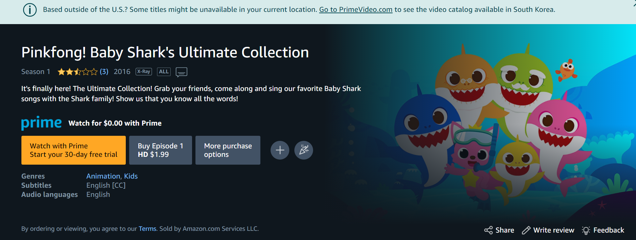
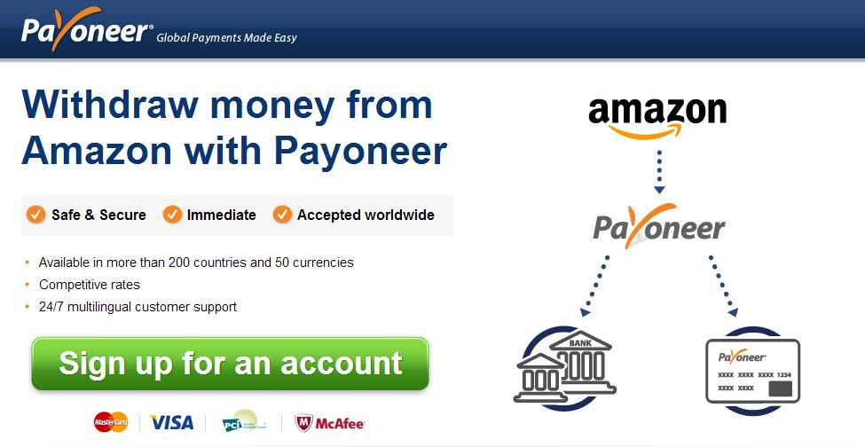
3.4 Product & Services

Slide 16
3.5 GME SWOT Analysis
STRENGTH: Massive local KRW currency Adjustable API functionalities & developments 3) Industry Pricing Insights & Partners need | WEAKNESS: 1) New PSP in the Payment Industry
OPPORTUNITIES : 1) Adapt partner requirements in our API solutions 2) Brand Recognition in the Global Markets | THREAT : 1) Difficult to compete with Bank such as Hana Bank 2) Other companies acquiring licenses and approaching the same potential partners

Slide 17
3.6 Methods to Achieve the Target
Product Strategy
Pricing Strategy
Place Strategy
Promotion Strategy
> Inbound Online Shopping
> Tuition Payments
> Competitive Pricing
> Business Networking.
> Promotional Fees
> Rebate
* Major updates on :
- Which company is expanding
- Which company getting Investment
- Which company looking for South Korea Market
* Approach the company with Payment Solution
- Value Proposition Proposal

Slide 18
4. Work Process
 | WBS | TASK TITLE | 담당 | START DATE | DUE DATE | DURATION
 | 1 | 준비 자료
Business | 1.1 | 사업계획 (매출액 계획) | 요엘 | 7-1-21 | 7-6-21 | 5.00
 | 1.2 | 비즈니스 모델 (당타발) | 요엘 | 7-15-21 | 7-30-21 | 15.00
 | 1.3 | Roadmap 및 목표 확정 | 요엘 | 7-1-21 | 7-30-21 | 29.00
 | 1.4 | 마케팅 (Linkedin, 경상거래 소개 페이지() | 요엘 | 7-15-21 | 7-30-21 | 15.00
 | 1.5 | KYC, AML Policy 준비 | 요엘 | 7-15-21 | 7-30-21 | 15.00
 | 1.6 | NDA, DD 서류를 준비 (wolfberg) | 요엘 | 7-15-21 | 7-30-21 | 15.00
 | 1.7 | Customer Onboarding Questionnaire (준비) | 요엘 | 7-15-21 | 7-30-21 | 15.00
 | 2 | 서비스
Product | 2.1 | E-커머스 (Amazon, Ebay, Gmarket) | 요엘 | 7-15-21 | 7-30-21 | 15.00
 | 2.2 | 학자금 (US, Canada, Australia) | 요엘 | 8-15-21 | 8-30-21 | 15.00
 | 2.3 | 정산 및 직금 (머전트) | 요엘 | 7-15-21 | 7-30-21 | 15.00
 | 2.4 | 선불카드 | 요엘 | 8-20-21 | 8-30-21 | 10.00
 | 2.5 | GME 페이먼트 플랫폼 (당발) | 요엘 | 8-15-21 | 8-30-21 | 15.00
 | 3 | 기술지원
Technical | 3.1 | API 개발 및 가이드라인 | 요엘 | 9-1-21 | 10-20-21 | 49.00
 | 3.2 | Member ID (method and Info) | 요엘 | 9-1-21 | 10-20-21 | 49.00
 | 3.3 | Designate Application Engineer for Integration | 요엘 | 9-1-21 | 10-20-21 | 49.00
 | 3.4 | parameters, Invoice, reason codes | 요엘 | 9-1-21 | 10-20-21 | 49.00
 | 3.5 | Mininum viable product | 요엘 | 9-1-21 | 10-20-21 | 49.00
 | 3.6 | Backoffice and Partner office | 요엘 | 11-1-21 | 11-30-21 | 29.00

Slide 19
4. Work Process
 | 4 | 내부 및 외부 준비 사항
Operation | 4.1 | 은행 협조 | 회계, 재무 | 9-20-21 | 10-20-21 | 30.00
 | 4.2 | 계좌 (multicurrency account) | 회계, 재무 | 11-1-21 | 11-20-21 | 19.00
 | 4.3 | Refund and communication | 운영 | 11-1-21 | 11-20-21 | 19.00
 | 4.4 | Error & trouble shooting | 운영 | 11-1-21 | 11-20-21 | 19.00
 | 4.4 | compliance road-map (보고 등) | 운영 | 9-20-21 | 10-20-21 | 30.00
 | 4.4 | 고객지원, Account Manager | 요엘, 계획팀 | 11-1-21 | 12-30-21 | 59.00
 | 5 | 운영 지원
Testing | 5.1 | 운영 지원 담당자 | 운영팀 | 12-1-21 | 12-30-21 | 29.00
 | 5.2 | Quality assurance | 운영팀 | 12-1-21 | 12-30-21 | 29.00
 | 5.3 | 개발자 | IT + Operation | 9-20-21 | 12-30-21 | 101.00
 | 5.4 | 내부 ticket 생선 및 운영자 | IT + Operation | 9-20-21 | 12-30-21 | 101.00
 | 5.5 | Implementation 확인자 | PG Team | 9-20-21 | 12-30-21 | 101.00
 | 6 | Service Delivery
Production | 6.1 | review & confirmation | 요엘 | 10-1-21 | 10-30-21 | 29.00
 | 6.2 | API, System, Data | 기술팀 | 10-1-21 | 10-30-21 | 29.00
 | 6.3 | Funding and kickoff | PG Team | 10-1-21 | 10-30-21 | 29.00
 | 7 | Business Development
Account Mgt | 7.1 | Airwallex | 요엘 | 8-1-21 | 10-30-21 | 90.00
 | 7.2 | ipayLinks | 요엘 | 8-1-21 | 10-30-21 | 90.00
 | 7.3 | Payoneer | 요엘 | 8-1-21 | 3-30-22 | 241.00
 | 7.4 | PingPong | 요엘 | 8-1-21 | 3-30-22 | 241.00
 | 7.5 | Transfermate | 요엘 | 8-1-21 | 3-30-22 | 241.00
 | 7.6 | Transfereasy | 요엘 | 8-1-21 | 3-30-22 | 241.00
 | 7.8 | Currencloud | 요엘 | 8-1-21 | 3-30-22 | 241.00
 | 7.9 | LianLianPay | 요엘 | 8-1-21 | 3-30-22 | 241.00

Slide 20
5. RoadMap | Next 3 months | 4 to 6 months | 7 to 9 months | 10 to 12 months
Acquire License & Banking Partner | * Acquire PG License by the end of September | * Setup local Bank Account for Cross border payment (USD Account)
Business Plan and Target | * Business Plan for acquiring License * Business Plan for API development * Business Plan to Partnership Proposal
Minimum viable Product for Service | * Batch processing Format API * Local fund payout Channel agreement |  | * Develop API parameters, functionalities
API development |  | * GME Cross border payment API Development, Manual Guide
Back office & Partner Office |  | * Required Functionalities in Cross border payment Industry (Back office) | * Develop Partner Office | * Add Virtual Account Issuance
Cross border payment Page |  | * Introductory Page and Merchant Onboarding Platform for requesting payment and sending out Payment
Operation & netting |  |  | * Local Netting process setup
Cross border payment collection |  |  |  | * Offer Local collection payment method (compliance, regulatory check)

Slide 21
6. Conclusion & Goal
200Mil USD Volume by 2023 with 1.6% Market Share
Starting with Inbound Online Shopping Settlement for Chinese Vendors.
Thank you

Slide 22
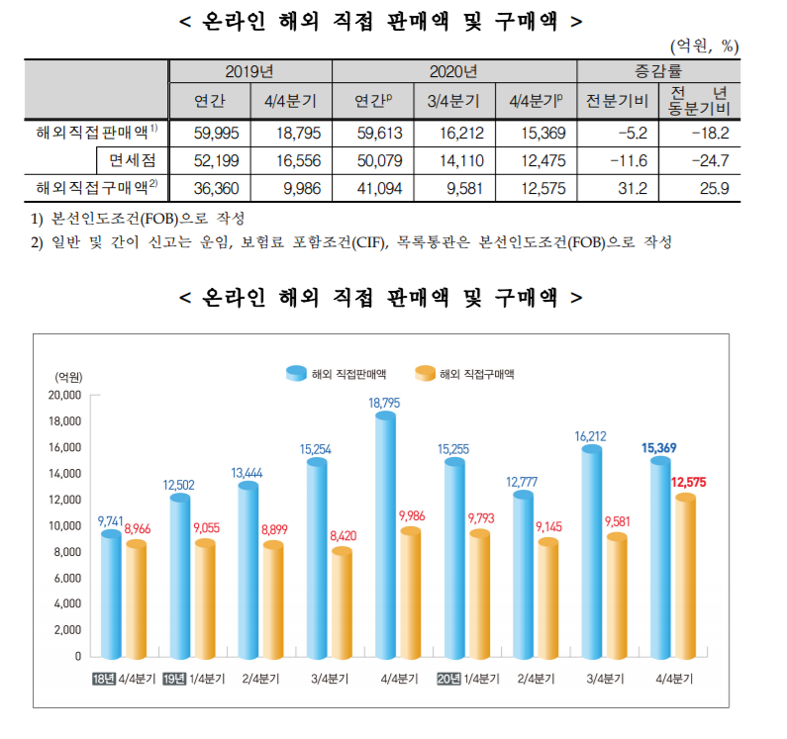
Appendix. 1
Source: 통계청
Notes:
5조 9천 995억 for selling in 2019.

Slide 23
Appendix 2.
2020년 국외 고등교육기관 한국인 유학생 통계
Year | 2016 | 2017 | 2018 | 2019 | 2020
No of Students | 223,908 | 239,824 | 220,930 | 213,000 | 194,916
다. 주요 국가별 현황
 |  |  |  |  |  |  |  | (매년 4.1 기준, 단위 : 명)
Year | USA | China | Australia | Japan | Canada | Germany | France | Others | Total
2018 | 58,663 | 63,827 | 16,801 | 15,740 | 12,279 | 6,527 | 6,475 | 40,618 | 220,930
Percentage(%) | 26.6% | 28.9% | 7.6% | 7.1% | 5.6% | 3.0% | 2.9% | 18.4% | 100.0%
2019 | 54,555 | 50,600 | 18,766 | 17,012 | 16,495 | 6,835 | 6,948 | 41,789 | 213,000
Percentage(%) | 25.6% | 23.8% | 8.8% | 8.0% | 7.7% | 3.2% | 3.3% | 19.6% | 100.0%
2020 | 52,250 | 47,146 | 13,026 | 18,338 | 16,325 | 7,066 | 7,090 | 33,675 | 194,916
Percentage(%) | 26.8% | 24.2% | 6.7% | 9.4% | 8.4% | 3.6% | 3.6% | 17.3% | 100.0%
지역별 유학생수
 |  |  |  | (2020.4.1 기준, 단위 : 명)
Area | 학위과정 |  |  | Others | Total
 | Undergrad | Grad | Total
Asia | 32,950 | 5,774 | 38,724 | 36,951 | 75,675
USA | 32,767 | 20,220 | 52,987 | 15,639 | 68,626
Europe | 9,603 | 8,680 | 18,283 | 12,857 | 31,140
Oceania | 14,045 | 743 | 14,788 | 3,681 | 18,469
Africa | 22 | 8 | 30 | 513 | 543
Latin America | 79 | 36 | 115 | 348 | 463
Total | 89,466 | 35,461 | 124,927 | 69,989 | 194,916
Source: 교육부
Source: 교육부

